Slide 1
Infant Respiratory Rate Monitor
Sean Ermer
Tim Lau
Leo Li
Mentor: Dr. Daniel Moran
Notes:
Our project is the infant respiratory rate monitor. It’s a project put forth by engineering world health in their annual “projects that matter” list. The list details problems in the developing world and seeks the help of engineers in creating a cheap and effective solution which could be implemented abroad to save lives and improve quality of life.

Slide 2
Background
SIDS—Sudden Infant Death Syndrome¹
Sleep Apnea¹
Central
Obstructive
Mixed
¹PEDIATRICS Vol. 111 No. 4 April 1, 2003 pp. 914 -917
Notes:
SIDS has been defined as “the sudden death of an infant under 1 year of age that remains unexplained after a thorough case investigation, including performance of a complete autopsy, examination of the death scene, and review of the clinical history.”¹⁷
Apnea of infancy is defined as “an unexplained episode of cessation of breathing for 20 seconds or longer, or a shorter respiratory pause associated with bradycardia, cyanosis, pallor, and/or marked hypotonia.” The term “apnea of infancy” generally refers to infants with gestational age of 37 weeks or more at the onset of apnea.¹⁸
Central Apnea usually denotes a problem in the pathways of the brain which control respiration.
Obstructive Apnea denotes a physical blockage of the pathway—airway to the throat relaxes and obstructs itself

Slide 3
Background
Risk Factors²
Infection
Low blood sugar
Environment
Premature birth
Neurological problems
Treatment Options²
Physical intervention
Oxygen mask
Drugs
²Emory School of Medicine Department of Pediatrics
http://www.pediatrics.emory.edu/divisions/neonatology/parent_info3.html
Notes:
University of Emory found that patients who were most at risk included infection, low blood sugar, low blood oxygen, environmental factors, airway problems, neurological problems
Infants who are at risk for sleep apnea are usually heavily monitored. If the nurse is aware of the episode occuring, she will begin to check all the baby’s vitals. If the baby does not recover physical chest stimulation may be required. Stimulants such as caffiene and other drugs may also be given along with an oxygen mask if the infant has a recurring problem.

Slide 4
Need
Solution: A device which can cheaply monitor an infant for sleep apnea and alert a nurse via an alarm
2,250 babies die in the U.S. every year to SIDS³
Developing countries tend to have higher death rates
Apnea affects about 2% of all infants⁴
³Center for Disease Control
http://www.cdc.gov/sids/
⁴Sleep Apnea and Your Child
(Copyright 2003 American Academy of Pediatrics)
Notes:
2,250 babies die in the U.S. every year to SIDS³
Many developing countries are understaffed and can not possibly monitor every baby for symptoms and risk factors.
Engineering world health believes that a device which monitors infants and can alert nurses to sleep apnea would drastically reduce the amount of deaths per year in developing countries.

Slide 5
Scope
Cheap
Small
Detachable
Straight forward
Loud
Capable
Precise
Reliable
Notes:
Small enough to attach the side of a crib.
Detachable so that the device can be moved between cribs.
Cheap and affordable to make and implement.
Straight forward and does not require training to use.
Loud and audible from reasonable distances.
Capable of detecting breathing cessation greater than 20 seconds.
Precise and sensitive to breathing cessation.
Reliable and requires little, if any, maintenance.

Slide 6
Specific Design Requirements
Less than $60
Detects breathing cessations of 20s or longer
Alarm is audible from outside the room
Comfortable for the infant
Design completed by December 2012

Slide 7
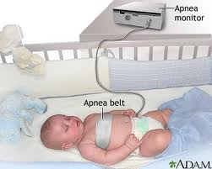
Existing Solutions
Healthdyne 970
smart apnea monitor
Uses electrodes
under a belt to
measure impedance
http://www.dremed.com

Slide 8
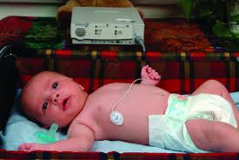
Existing Solutions
Respironics
smart monitor 2
Electrodes under
a belt measure
changes in
impedance
http://www.medicalsuppliesshop.com

Slide 9
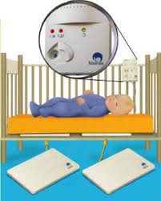
Existing Solutions
Babysense 2
Pressure pads
sense movement
http://www.oricom.com.au

Slide 10
Patent Search
US Patent # | Description
4895162 | Belt with electrodes
2006/0047217 | Pressure pads
5295490 | Elastic belt
4738266 | Infrared CO₂ monitor
4928703 | Infrared absorption of oxygen

Slide 11
Directions
Pressure sensing bed
Waterbed
Piezoelectric pad
Infrared Detectors
Expired gas
Infrared motion sensing

Slide 12
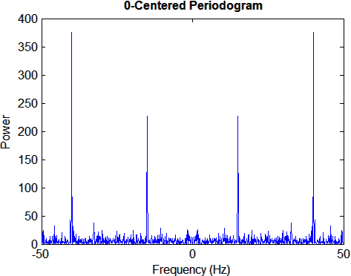
Fast Fourier Transform

Slide 13
Sampling Rate
Nyquist frequency= 2*highest frequency
Infant respiratory rate= .5-1 Hz
Lowest acceptable rate=2 Hz

Slide 14
Displacement
Tidal capacity ~ 50-80 mL⁵ =60% increase
60% increase in volume = 16% increase in radius
Assume r_{lungs} about 7 centimeters at rest
r_{lungs}=8.14 cm at max
⁵Eur Respir J 1998; 12: 1186–1190
Notes:
V2=1.6*v1
V1=4/3*pi*r1^3
V2=

Slide 15
Design Schedule
24-Sep |  |  | 8-Oct |  |  | 22-Oct |  |  | 5-Nov |  |  | 19-Nov |  |  | 5-Dec
 | Website
 | Preliminary Design Research
 |  | Risk Analysis
 |  |  |  |  |  |  |  | Final Design
 |  |  |  |  |  |  |  |  |  |  | Web Page Finished

Slide 16
Organization
Sean Ermer | Tim Lau | Leo Li
Physical Design Ergonomics Pricing | Web Page Programming Research | Group Contact System Modeling Calculations

Slide 17
Conclusion
Thank You!
Questions?

