Slide 1
Infant Respiratory Rate Monitor Group 11
Sean Ermer
Tim Lau
Leo Li
Mentor: Dr. Daniel Moran

Slide 2
Need
Engineering World Health (EWH) Projects that Matter
Greatly improve mortality rate of infants worldwide
Not home monitoring
Apnea of Prematurity and SIDS
Cost efficient
Notes:
SIDS has been defined as “the sudden death of an infant under 1 year of age that remains unexplained after a thorough case investigation, including performance of a complete autopsy, examination of the death scene, and review of the clinical history.”¹⁷
Apnea of infancy is defined as “an unexplained episode of cessation of breathing for 20 seconds or longer, or a shorter respiratory pause associated with bradycardia, cyanosis, pallor, and/or marked hypotonia.” The term “apnea of infancy” generally refers to infants with gestational age of 37 weeks or more at the onset of apnea.¹⁸
Central Apnea usually denotes a problem in the pathways of the brain which control respiration.
Obstructive Apnea denotes a physical blockage of the pathway—airway to the throat relaxes and obstructs itself

Slide 3
Need
4 million neonatal deaths per year
Notes:
SIDS has been defined as “the sudden death of an infant under 1 year of age that remains unexplained after a thorough case investigation, including performance of a complete autopsy, examination of the death scene, and review of the clinical history.”¹⁷
Apnea of infancy is defined as “an unexplained episode of cessation of breathing for 20 seconds or longer, or a shorter respiratory pause associated with bradycardia, cyanosis, pallor, and/or marked hypotonia.” The term “apnea of infancy” generally refers to infants with gestational age of 37 weeks or more at the onset of apnea.¹⁸
Central Apnea usually denotes a problem in the pathways of the brain which control respiration.
Obstructive Apnea denotes a physical blockage of the pathway—airway to the throat relaxes and obstructs itself

Slide 4
Need
1.4 million deaths for Asphyxiation and SIDS
Notes:
SIDS has been defined as “the sudden death of an infant under 1 year of age that remains unexplained after a thorough case investigation, including performance of a complete autopsy, examination of the death scene, and review of the clinical history.”¹⁷
Apnea of infancy is defined as “an unexplained episode of cessation of breathing for 20 seconds or longer, or a shorter respiratory pause associated with bradycardia, cyanosis, pallor, and/or marked hypotonia.” The term “apnea of infancy” generally refers to infants with gestational age of 37 weeks or more at the onset of apnea.¹⁸
Central Apnea usually denotes a problem in the pathways of the brain which control respiration.
Obstructive Apnea denotes a physical blockage of the pathway—airway to the throat relaxes and obstructs itself

Slide 5
Specific Design Requirements
“We would like to develop a low-cost and highly reliable detection system that could alert nearby adults when breathing stops, giving them a chance to wake or resuscitate the infant. The device must be able to detect a breathing pause of 20 seconds or more and output an audible alarm signal when that happens.”
-EWH
Notes:
SIDS has been defined as “the sudden death of an infant under 1 year of age that remains unexplained after a thorough case investigation, including performance of a complete autopsy, examination of the death scene, and review of the clinical history.”¹⁷
Apnea of infancy is defined as “an unexplained episode of cessation of breathing for 20 seconds or longer, or a shorter respiratory pause associated with bradycardia, cyanosis, pallor, and/or marked hypotonia.” The term “apnea of infancy” generally refers to infants with gestational age of 37 weeks or more at the onset of apnea.¹⁸
Central Apnea usually denotes a problem in the pathways of the brain which control respiration.
Obstructive Apnea denotes a physical blockage of the pathway—airway to the throat relaxes and obstructs itself

Slide 6
Specific Design Requirements
Attribute | Requirement
Size | Fit within a typical crib (1 m x 0.8 m x 0.5 m)
Mobility | Easily moved from crib to crib (Weigh < 3 lb)
Ease of Use | Does not require extensive mechanical/electrical knowledge
Recognizable and Audible | Able to draw nurse’s attention from reasonable distances
Accurate | Detect breathing cessation for > 20 sec
Reliable | Few false alarms
Non-invasiveness | Does not affect infant’s breathing
Cost | Must cost < $20 to manufacture and implement
Novelty | Does not infringe on existing patents
Notes:
SIDS has been defined as “the sudden death of an infant under 1 year of age that remains unexplained after a thorough case investigation, including performance of a complete autopsy, examination of the death scene, and review of the clinical history.”¹⁷
Apnea of infancy is defined as “an unexplained episode of cessation of breathing for 20 seconds or longer, or a shorter respiratory pause associated with bradycardia, cyanosis, pallor, and/or marked hypotonia.” The term “apnea of infancy” generally refers to infants with gestational age of 37 weeks or more at the onset of apnea.¹⁸
Central Apnea usually denotes a problem in the pathways of the brain which control respiration.
Obstructive Apnea denotes a physical blockage of the pathway—airway to the throat relaxes and obstructs itself

Slide 7
Specific Design Requirements
Attribute | Requirement
Size | Fit within a typical crib (1 m x 0.8 m x 0.5 m)
Mobility | Easily moved from crib to crib (Weigh < 3 lb)
Ease of Use | Does not require extensive mechanical/electrical knowledge
Recognizable and Audible | Able to draw nurse’s attention from reasonable distances
Accurate | Detect breathing cessation for > 20 sec
Reliable | Few false alarms
Non-invasiveness | Does not affect infant’s breathing
Cost | Must cost < $20 to manufacture and implement
Novelty | Does not infringe on existing patents
Notes:
SIDS has been defined as “the sudden death of an infant under 1 year of age that remains unexplained after a thorough case investigation, including performance of a complete autopsy, examination of the death scene, and review of the clinical history.”¹⁷
Apnea of infancy is defined as “an unexplained episode of cessation of breathing for 20 seconds or longer, or a shorter respiratory pause associated with bradycardia, cyanosis, pallor, and/or marked hypotonia.” The term “apnea of infancy” generally refers to infants with gestational age of 37 weeks or more at the onset of apnea.¹⁸
Central Apnea usually denotes a problem in the pathways of the brain which control respiration.
Obstructive Apnea denotes a physical blockage of the pathway—airway to the throat relaxes and obstructs itself

Slide 8
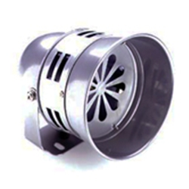
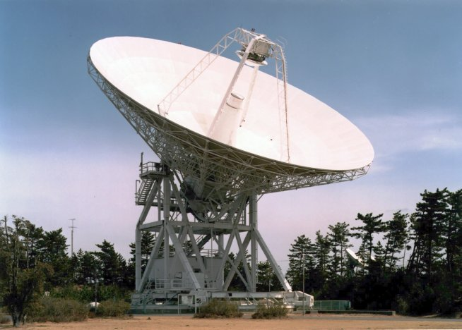
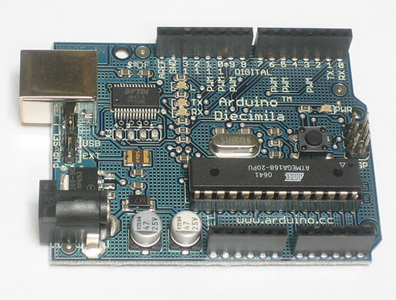
Design Alternatives
Basic Layout
Sensor
Interpreter
Alarm

Slide 9
Design Alternatives
Basic Layout
Sensor
Interpreter
Alarm

Slide 10
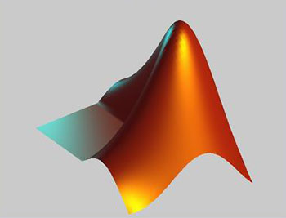
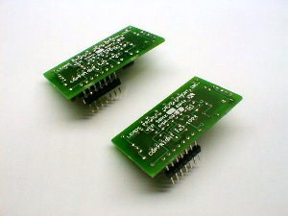
Interpreter
Computer
Hardware
Microprocessor
Computationally Powerful
Expensive and Difficult to Implement
Energy Efficient
Expensive and Difficult to Implement
Not as powerful as computer, but enough for our purposes
Cheap to manufacture and utilize

Slide 11
Interpreter
Computation | Weight | Hardware | Microcontroller | Computer
Simplicity | 8 | 1 | 10 | 10
Processing Power | 5 | 3 | 6 | 10
Energy | 4 | 9 | 10 | 4
Memory | 4 | 5 | 5 | 10
RAM | 4 | 5 | 5 | 10
Cost | 10 | 4 | 9 | 2
Total | 35 | 139 | 280 | 246

Slide 12
Interpreter
Computation | Weight | Hardware | Microcontroller | Computer
Simplicity | 8 | 1 | 10 | 10
Processing Power | 5 | 3 | 6 | 10
Energy | 4 | 9 | 10 | 4
Memory | 4 | 5 | 5 | 10
RAM | 4 | 5 | 5 | 10
Cost | 10 | 4 | 9 | 2
Total | 35 | 139 | 280 | 246

Slide 13
Design Alternatives
Basic Layout
Sensor
Interpreter
Alarm

Slide 14
Sensor
Magnetic
Capacitive
Piezoelectric
Impedance
Mechanical
Pressure
Accelerometer
LED
Photoelectric

Slide 15
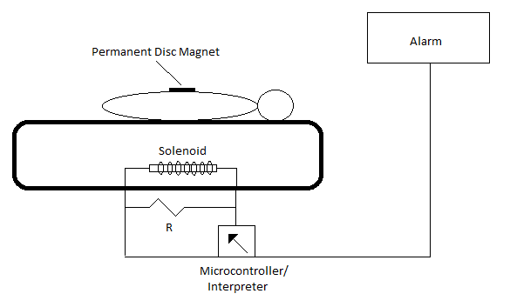
Magnetic

Slide 16
Magnetic
Model infant’s chest as an expanding and contracting circle
$EMF=−N∗\frac{dΦ}{dt}≈−N∗\frac{△(B∗A)}{△t}$
Total EMF: order of microvolts
Magnetic field might affect other instruments
Conclusion: Not very effective

Slide 17
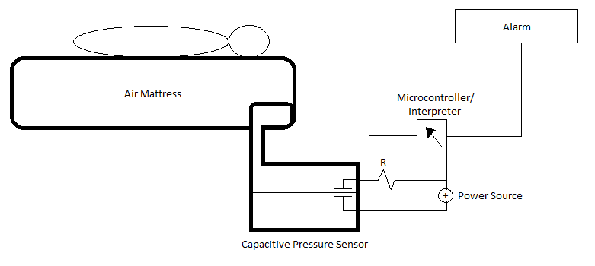
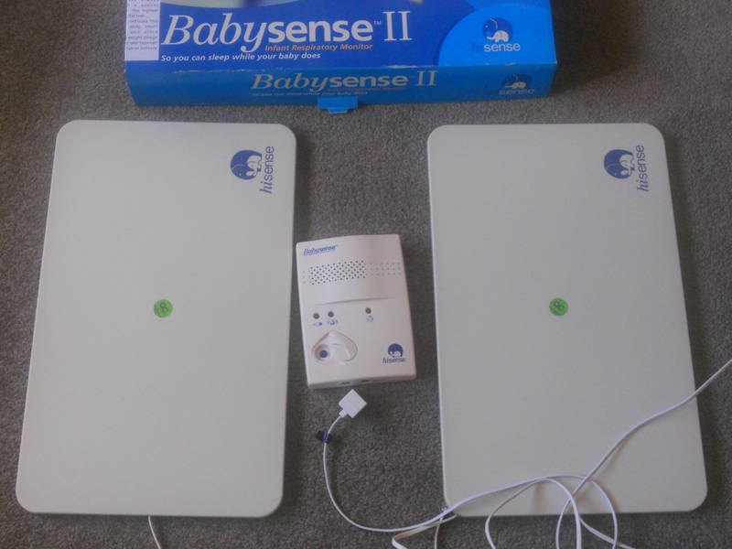
Pressure

Slide 18
Pressure
Easy to implement
On a larger scale, would be very effective
Costly
Not mobile
On our scale: 0.06 Pa
Novelty
Conclusion: Not very effective

Slide 19
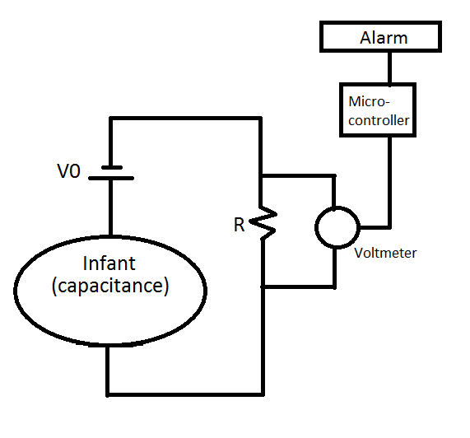
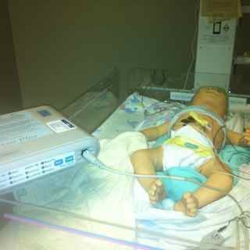
Impedance

Slide 20
Impedance
Can be very accurate
Easy to implement
Computationally heavy
Effects on breathing/infant
Novelty
Conclusion: Not very effective

Slide 21
Design Alternatives
Specification | Weight | Piezoelectric | Magnetic | Pressure | Impedance
Size and Weight | 5 | 6 | 3 | 5 | 6
Mobility | 6 | 9 | 3 | 4 | 9
Novelty | 7 | 8 | 10 | 4 | 3
Non-invasiveness | 8 | 9 | 6 | 8 | 6
Cost | 10 | 10 | 10 | 7 | 5
Ease of use | 7 | 9 | 6 | 5 | 10
Reliability | 9 | 9 | 5 | 2 | 8
Accuracy | 9 | 9 | 5 | 3 | 6
Total | 61 | 537 | 383 | 291 | 399

Slide 22
Design Alternatives
Specification | Weight | Piezoelectric | Magnetic | Pressure | Impedance
Size and Weight | 5 | 6 | 3 | 5 | 6
Mobility | 6 | 9 | 3 | 4 | 9
Novelty | 7 | 8 | 10 | 4 | 3
Non-invasiveness | 8 | 9 | 6 | 8 | 6
Cost | 10 | 10 | 10 | 7 | 5
Ease of use | 7 | 9 | 6 | 5 | 10
Reliability | 9 | 9 | 5 | 2 | 8
Accuracy | 9 | 9 | 5 | 3 | 6
Total | 61 | 537 | 383 | 291 | 399

Slide 23
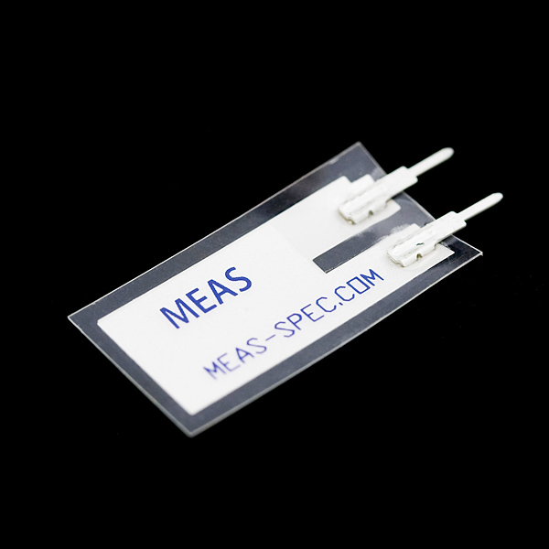
Piezoelectric
Materials that generate a voltage when deformed
Relatively Cheap (approximately $3)
Can generate relatively large currents

Slide 24
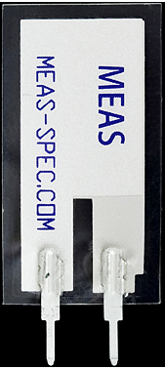
Piezoelectric
SEN-09196
PVDF
2
1
3
Different electrical properties for different stresses/strains
Strong

Slide 25
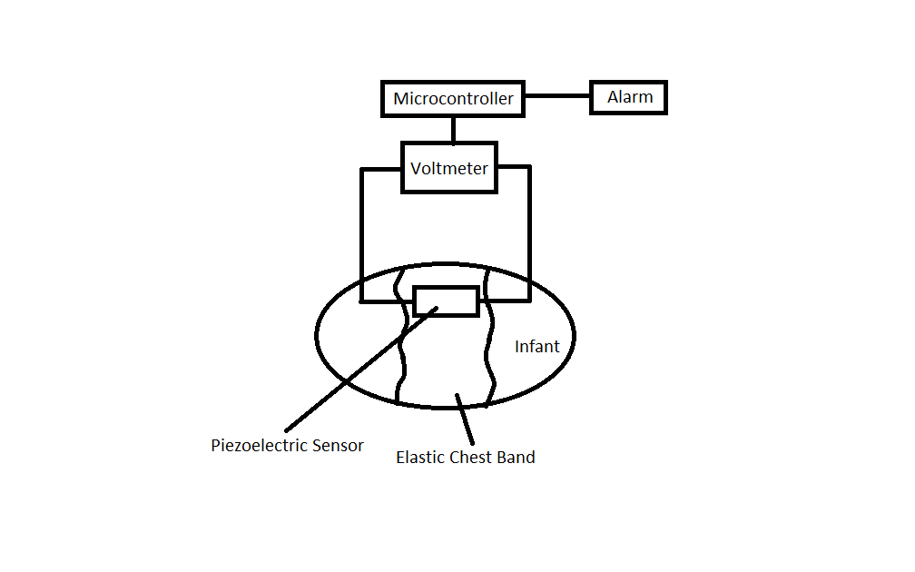
Piezoelectric

Slide 26
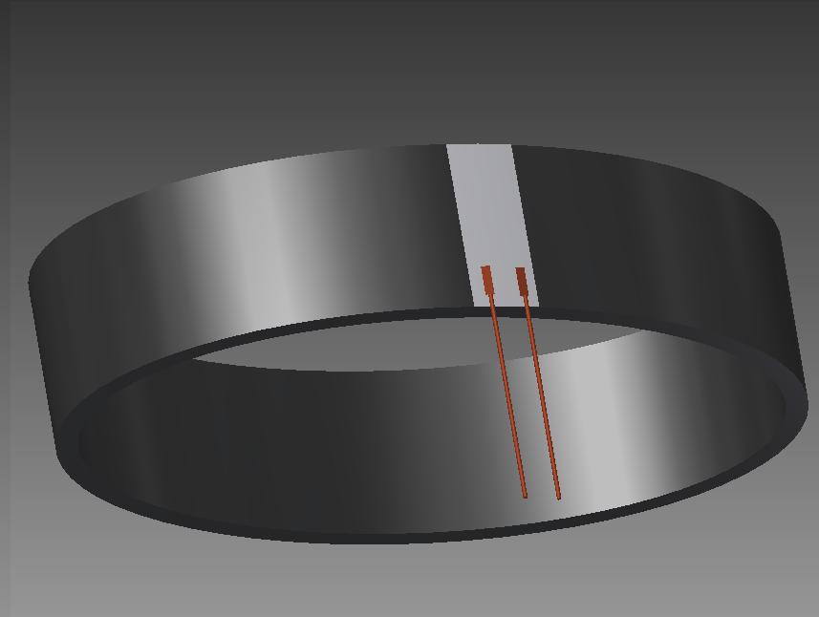
Piezoelectric

Slide 27
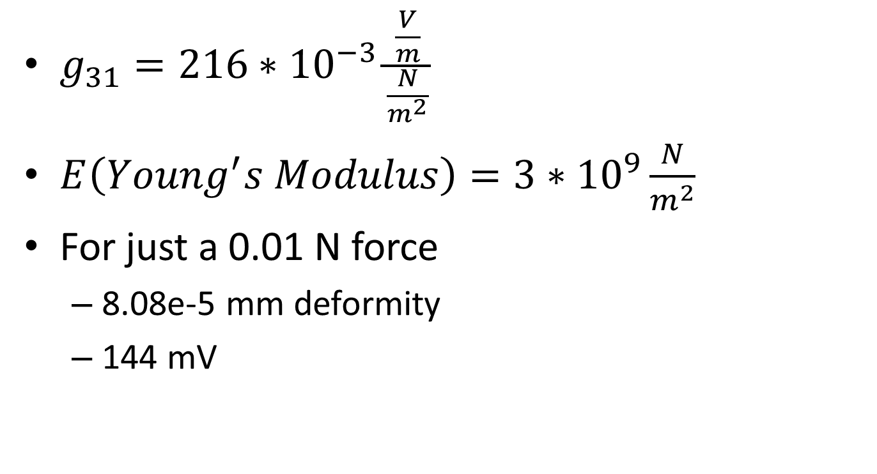
Piezoelectric
$g_{31}=216∗{10}^{−3}\frac{\frac{V}{m}}{\frac{N}{m^{2}}}$
$E\left(Young^{′}s Modulus\right)=3∗{10}^{9}\frac{N}{m^{2}}$
For just a 0.01 N force
8.08e-5 mm deformity
144 mV

Slide 28
Piezoelectric
Conclusions:
Cost effective
Large voltage generated
Safe and non-invasive
Easy to implement (with strap)
Reliable and accurate

Slide 29
Design Schedule

Slide 30
Organization
Sean Ermer | Tim Lau | Leo Li
Physical Design CAD Design Ergonomics Product Selection | Web Page Management Circuit Design Programming Research Final Presentation | Group Contact System Modeling Calculations Risk Analysis

Slide 31
Thank You!
Questions?

