Slide 1
Infant Respiratory Rate Monitor Group 11
Sean Ermer
Tim Lau
Leo Li
Mentor: Dr. Daniel Moran

Slide 2
Need
Engineering World Health (EWH) Projects That Matter
Greatly improve mortality rates of infants worldwide
Not home monitoring
Apnea of Prematurity and SIDS
Cost efficient

Slide 3
Need
4 million neonatal deaths per year

Slide 4
Need
1.4 million deaths for Asphyxiation and SIDS

Slide 5
Specific Design Requirements
Attribute | Requirement
Size | Fit within a typical crib (1 m x 0.8 m x 0.5 m)
Mobility | Easily moved from crib to crib (Weigh < 3 lb)
Ease of Use | Does not require extensive mechanical/electrical knowledge
Recognizable and Audible | Able to draw nurse’s attention from reasonable distances
Accurate | Detect breathing cessation for > 20 sec
Reliable | Few false alarms
Non-invasiveness | Does not affect infant’s breathing
Cost | Must cost < $20 to manufacture and implement
Novelty | Does not infringe on existing patents

Slide 6
Specific Design Requirements
Attribute | Requirement
Size | Fit within a typical crib (1 m x 0.8 m x 0.5 m)
Mobility | Easily moved from crib to crib (Weigh < 3 lb)
Ease of Use | Does not require extensive mechanical/electrical knowledge
Recognizable and Audible | Able to draw nurse’s attention from reasonable distances
Accurate | Detect breathing cessation for > 20 sec
Reliable | Few false alarms
Non-invasiveness | Does not affect infant’s breathing
Cost | Must cost < $20 to manufacture and implement
Novelty | Does not infringe on existing patents

Slide 7
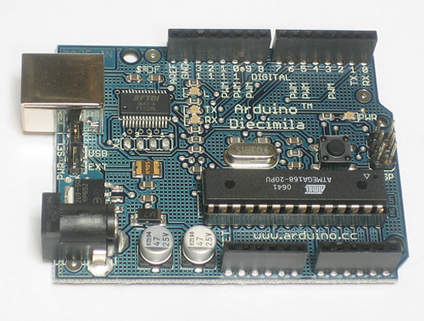
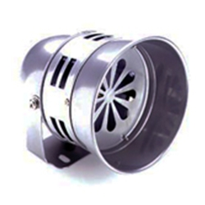
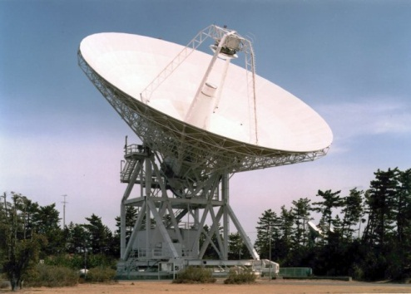
Design Components
Sensor
Interpreter
Alarm

Slide 8
Design Components
Sensor
Interpreter
Alarm
Piezo film
Microcontroller
PCB mount buzzer

Slide 9
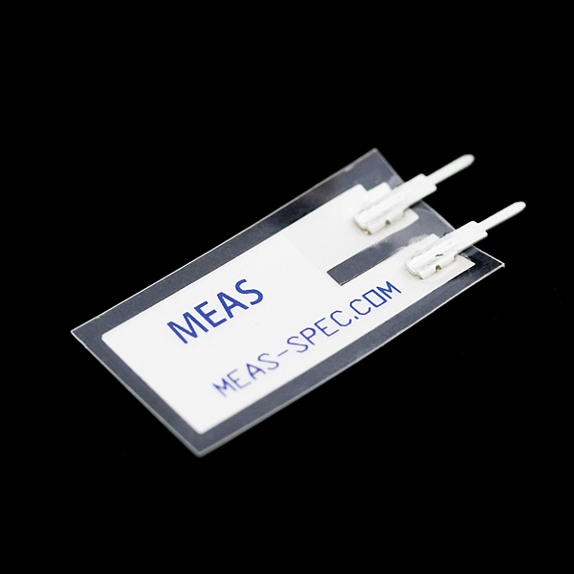
Sensor
Piezoelectric model
Materials that generate a voltage when deformed
Relatively inexpensive (approx. $3/unit)
Can generate relatively large currents

Slide 10
Model

Slide 11
Model
Monitor
Chest strap

Slide 12
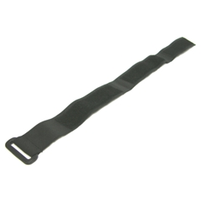
Chest Strap
71% polyester, 29% rubber
Spring constant ~5 N/m
3cm width, variable circumference
Velcro for easy adjustment
Fabric “pocket” for piezo strip

Slide 13
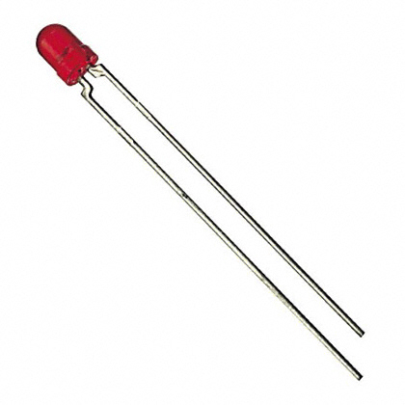
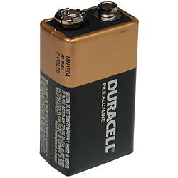
Monitor
Plastic casing
Outside: LED, on/off button
LED indicates low battery
Encloses circuitry for microcontroller, alarm
9V battery

Slide 14
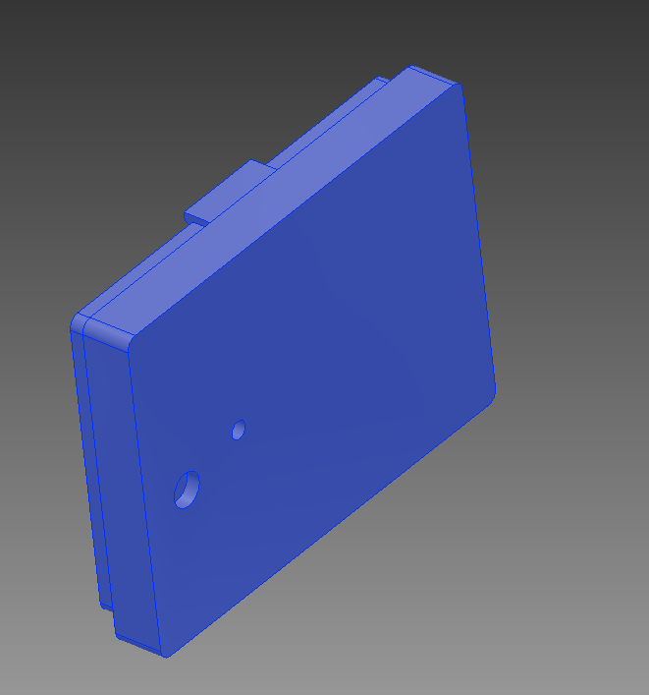
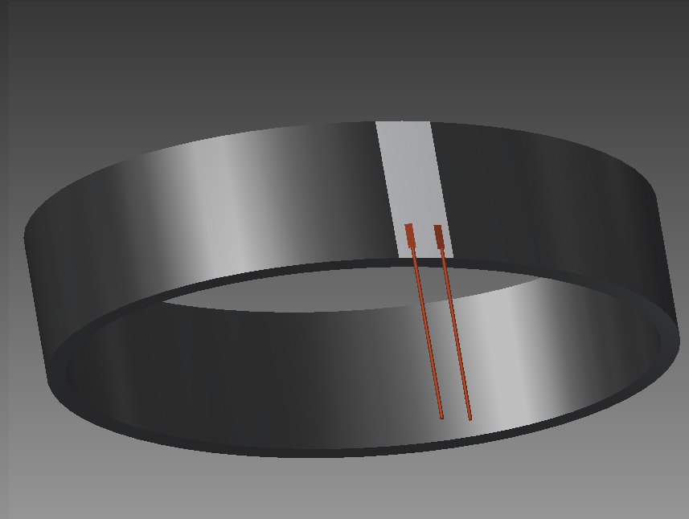
Product Components

Slide 15
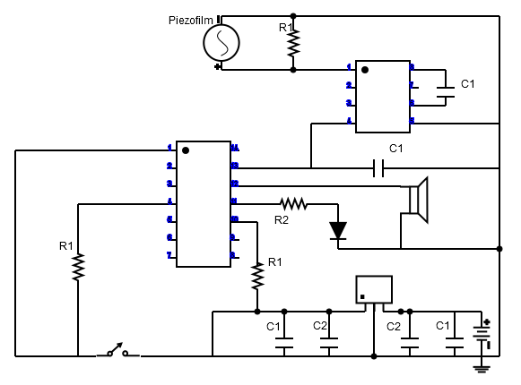
Circuit

Slide 16
Circuit
DC/DC converter
Microcontroller
Voltage regulator

Slide 17
Microcontroller
Metric | Weight | PIC10F220/222 | PIC12F510 | PIC16F506 | PIC12F615
Price | 10 | 9 | 9 | 7 | 5
RAM | 8 | 2 | 4 | 9 | 8
I/O Pins | 5 | 3 | 5 | 10 | 5
A/D Channels/Converters | 10 | 7 | 8 | 8 | 9
A/D Resolution | 7 | 8 | 8 | 8 | 10
Program Memory | 4 | 3 | 5 | 8 | 10
Total |  | 259 | 303 | 360 | 339

Slide 18
Microcontroller
Metric | Weight | PIC10F220/222 | PIC12F510 | PIC16F506 | PIC12F615
Price | 10 | 9 | 9 | 7 | 5
RAM | 8 | 2 | 4 | 9 | 8
I/O Pins | 5 | 3 | 5 | 10 | 5
A/D Channels/Converters | 10 | 7 | 8 | 8 | 9
A/D Resolution | 7 | 8 | 8 | 8 | 10
Program Memory | 4 | 3 | 5 | 8 | 10
Total |  | 259 | 303 | 360 | 339

Slide 19
Microcontroller: PIC16F506
Core functionality, inexpensive ($.62/unit)
14 pins
67 bytes RAM, 1.5kB program memory
High A/D resolution for comparator
4MHz oscillator
Will be slowed down to 32kHz to save energy
Gives ~38Hz sampling rate
Infant breathing rate .5-1Hz

Slide 20
Signal Acquisition
Piezo voltage corresponds to motion from breathing
For max displacement motion, 4V/-4V
DC/DC converter changes -ve signal to +ve
PIC16F506 cannot process -ve signal
Voltage regulator keeps steady input signal to microcontroller
Stable 5V input
Less opportunity for failure

Slide 21
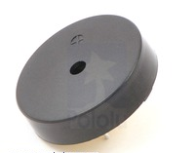
Alarm
Commercial 30mm PCB mount buzzer
Wide operating voltage range (1-30V)
Low current draw (~5mA)
95dB, 2.5kHz frequency sound

Slide 22
Power Consumption
Microcontroller clocked at 32kHz
38µA to run
Power regulator
200µA
~5000 hrs (or 7 months) to drain battery if continuously on
Assume energy cost of alarm, LED is negligible

Slide 23
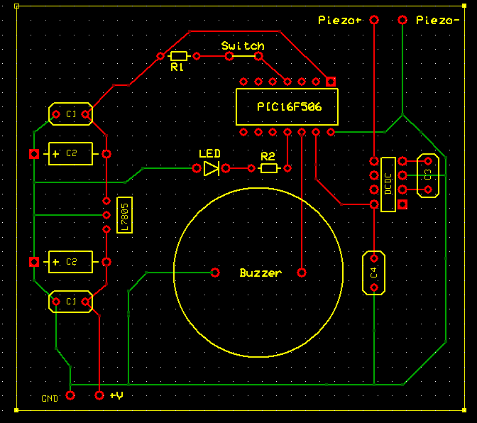
PCB
Cost: ~$7
3.1’’ x 2.8’’

Slide 24
Software Flow Chart

Slide 28
Safety
Most prominent safety issues:
Noise above 80dB
Power supply interruption
On/off switch and LED low battery indicator reduces these risks
Overall, very safe

Slide 29
DesignSafe

Slide 30
Assembly
Two options
Method 1: sell as complete package, no assembly required
Outsource manufacturing
Method 2: sell all individual parts with instructions on how to assemble product
Provides cheaper option for 3rd world countries

Slide 31
Parts
Total: $9.61
PCB lead time: 2-3 weeks
Plastic casing lead time: 2-4 weeks
Weight: Monitor 2.5oz, chest strap ~1.7oz
Part | Price ($)
Microcontroller | 0.62
Resistors | 0.15
DC/DC converter | 1.11
Battery connector | 0.29
9V battery | 0.88
LED | 0.04
Part | Price ($)
Piezo strip | 2.95
Button | 0.18
Alarm | 0.89
Breadboard | 1.16
Wiring (20 gauge) | 0.04
Plastic casing | 1.2
Elastic strap | 0.10

Slide 32
Conclusions
Met design specifications
Move on to working prototype, mass production
No IP
EWH non-profit
Disclosing design to public = lowest price
What did we learn?
What would we do different?

Slide 33
Thank you!
Questions?

